Slide 1
Gymnastics Blog
By: Kathlyn Miller-Francis

Slide 2
Introduction
My main goal in this project has never changed but I have made changes to make it look better.
Before started, I didn’t know what to do
What inspired me was doing a blog similar how I did my sophomore year
And I like making website because they are pretty easy to do.
I liked this project because it was mainly about what I liked and wanted to do.
So I decided to do a Gymnastics Blog because I love gymnastics and I did it in the past for about 10 years.

Slide 3
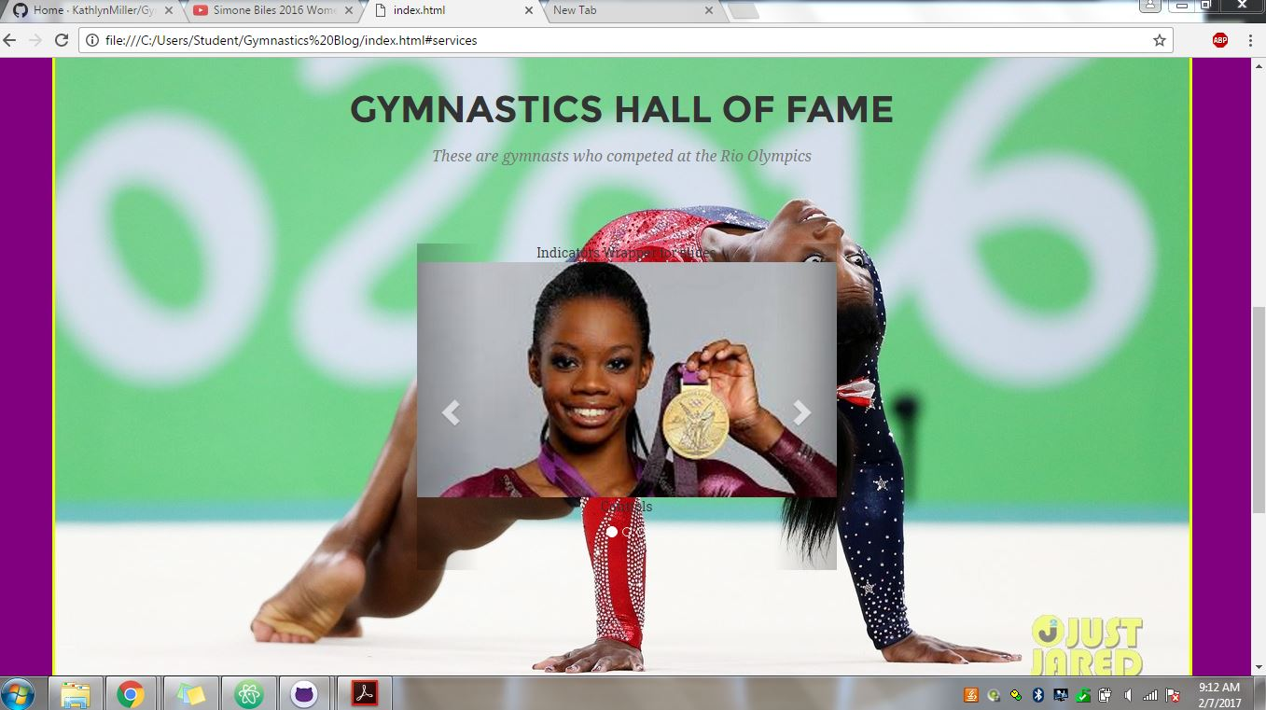
How it looked like at first

Slide 4
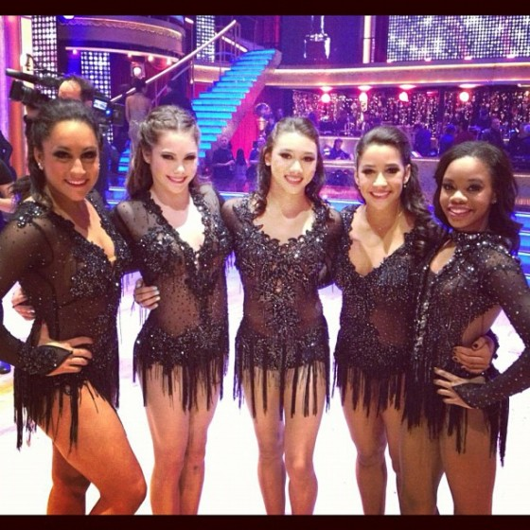
Unique
My website is unique by giving you an insight on what the Olympic Gymnasts at Rio 2016 are like and what they do outside of gymnastics.

Slide 5

Methods
I started out with using…
HTML
Bootstrap
JS
CSS
PHP
CodePen

Slide 6
Challenges
My challenges were to put some JS features in my website but I was able to do it without making any errors.
It was also hard to decide what gifs to put in my project to make it look more interesting.
I wanted to do a carousel but it didn’t look clean enough so I decided to take it out.

Slide 7
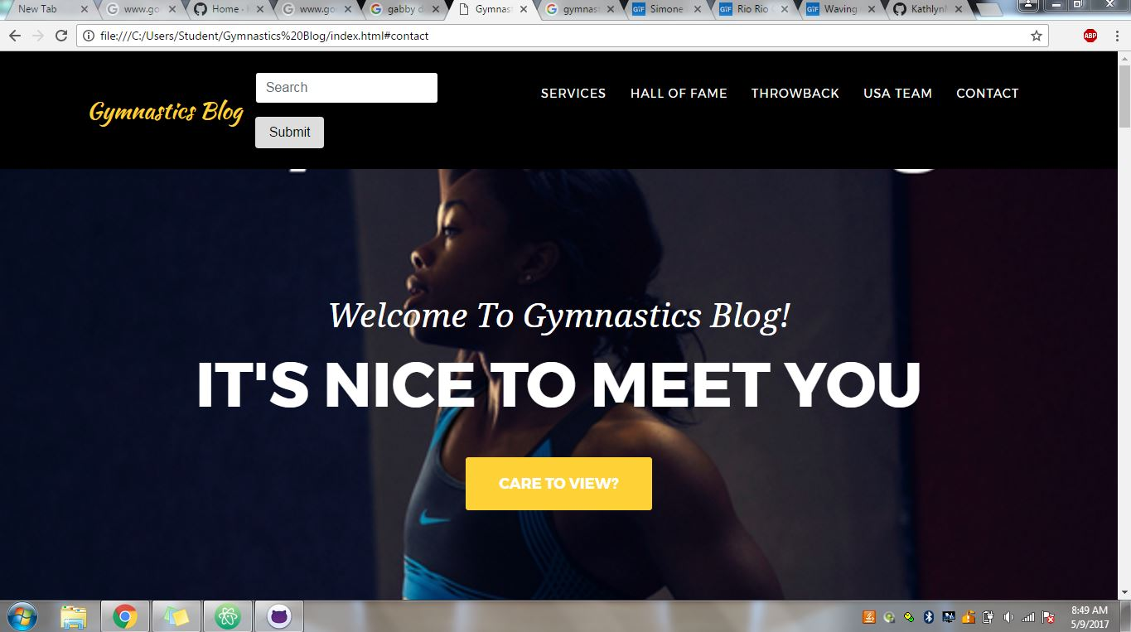
Final Project, New Features

Slide 8
Future Work
My last work on this project was to connect it to the server so that it can send messages/comments which would have been cool.
But other than that, I am satisfied on how my project looks and I am very proud of myself of what I made because I never thought I could achieve something like this.
Any Questions?

